Slide 1

Strategic Information Systems Management Section 5 Strategic IS/IM in Context Class Code: COMP423 H.Y Kan, Stanley Room: (WUI CHI) - 4/F, N46B Email: hykan@ipm.edu.mo Tel: 8599-6883

Slide 2
Learning Objectives
Understand the particular organizational contexts facing public sector organizations and SMEs
Understand the potential of public sector organizations and SMEs to transform their processes through the use of IS/IT
Analyse public sector IS/e-government initiatives using key theoretical frameworks
Identify the IS competencies required by SMEs
Critically discuss the issues and challenges facing public sector organizations and SMEs in their management and strategic use of IS/IT
Appreciate the differences and similarities faced by public sector organizations and SMEs regarding the strategic use of IS/IT

Slide 3
Introduction
Amazon, Dell, EasyJet, eBay, Google and Microsoft are well-known companies making use of ICTs to transform the way business can be conducted and the way we live our lives.
However, large private organizations are not the organizations who have to think strategically about information systems (IS) and information management (IM).
This chapter focuses on
Public sector organizations: Include some of the largest organizations of the world such as UK’s national health service (NHS) employing around 1.3 million people.
Small and medium-sized enterprises (SME): Can range from businesses with less than 10 employees to medium-sized businesses with between 50 and 250 employees.

Slide 4
The Nature of Public Sector Organizations
The public sector comprises the general government sector plus all public corporations including the central bank.
Examples:
Level | Indicative Examples
Global/supra-national | IMF; OECD; World Bank
Regional/inter and intra-regional | ASEAN; EU; NAFTA
National | National and state governments; state owned enterprises; state banks; treasury; health; trade; education; defence
Sub-national | Regional and local government; local agencies; regional development agencies
Community and neighbourhood | Town and district councils; primary health trusts

Slide 5
The Nature of Public Sector Organizations (Cont’d)
They differ from the private sector in several aspects:
Their goals, particularly the absence of the profit motive and competitive pressures
The greater variety of stakeholders and their goals
The role of public scrutiny
The political dimension
For example, the Scottish Government describes the “duty of best value in public services” as having two principles:
securing continuous improvement in performance whilst maintaining an appropriate balance between quality and cost;
having regard to economy, efficiency, effectiveness, the equal opportunities requirements and to contribute to the achievement of sustainable development

Slide 6
The Nature of Public Sector Organizations (Cont’d)
Stakeholders are individuals or groups who can influence the organization.
A stakeholder map is used to analyze the key stakeholders facing a public sector organization. It has two dimensions:
The stakeholder’s level of interest in the organization
The (political/influencing) power of the stakeholder
Depending on where the stakeholder is located on the map, different approaches for managing the relationship are suggested.
Low
Minimal Effort | Keep Informed
Keep Satisfied | Key Players
Power
High
Low
High
Level of Interest

Slide 7
The Nature of Public Sector Organizations (Cont’d)
Although large, the “public purse” is not without limit and governments must weigh up the sometimes conflicting priorities in keeping the citizens healthy, educated and safe. Consequently, public sector organizations operate under considerable scrutiny both in terms of public account or “oversight”; and scrutiny by the general public and mass media.
Governments come and go. Policies may change. This potential instability may lead to managers acting and reacting towards achieving short-term goals and objectives.
Managers within the public sector may have limited autonomy compared to their private sector counterparts, particularly regarding the processes of hiring, firing and promotion.
Nonetheless, we have observed a recent trend for the public sector organizations to be managed more like those in the private sector.

Slide 8
Electronic Government Applications
Electronic government (e-government) refers to the application of information technology to government processes in order to improve services to constituents.
A taxonomy of e-government applications:
Government to citizen (G2C)
Government to business (G2B)
Government to government (G2G)
Government internal efficiency and effectiveness (IEE)
Overarching infrastructure (cross-cutting)
Customer relationship management (CRM) is the metaphor for G2C and G2B where the focus is on interaction with customers (citizens or businesses) as well as learning about and meeting their needs through accessible and interactive channels.

Slide 9
Electronic Government Applications (Cont’d)
G2G applications can be seen as a form of supply chain management (SCM) with their focus on linking the information flow between various agencies (who may supply each other with data).
The focus on IEE is akin to enterprise resource planning systems where creating an integrated view of data and information is crucial.
The infrastructure/cross-cutting initiatives are a form of enterprise application integration (EAI) focusing on interoperability across departments and agencies.
E-government is widely practiced across the world.

Slide 10
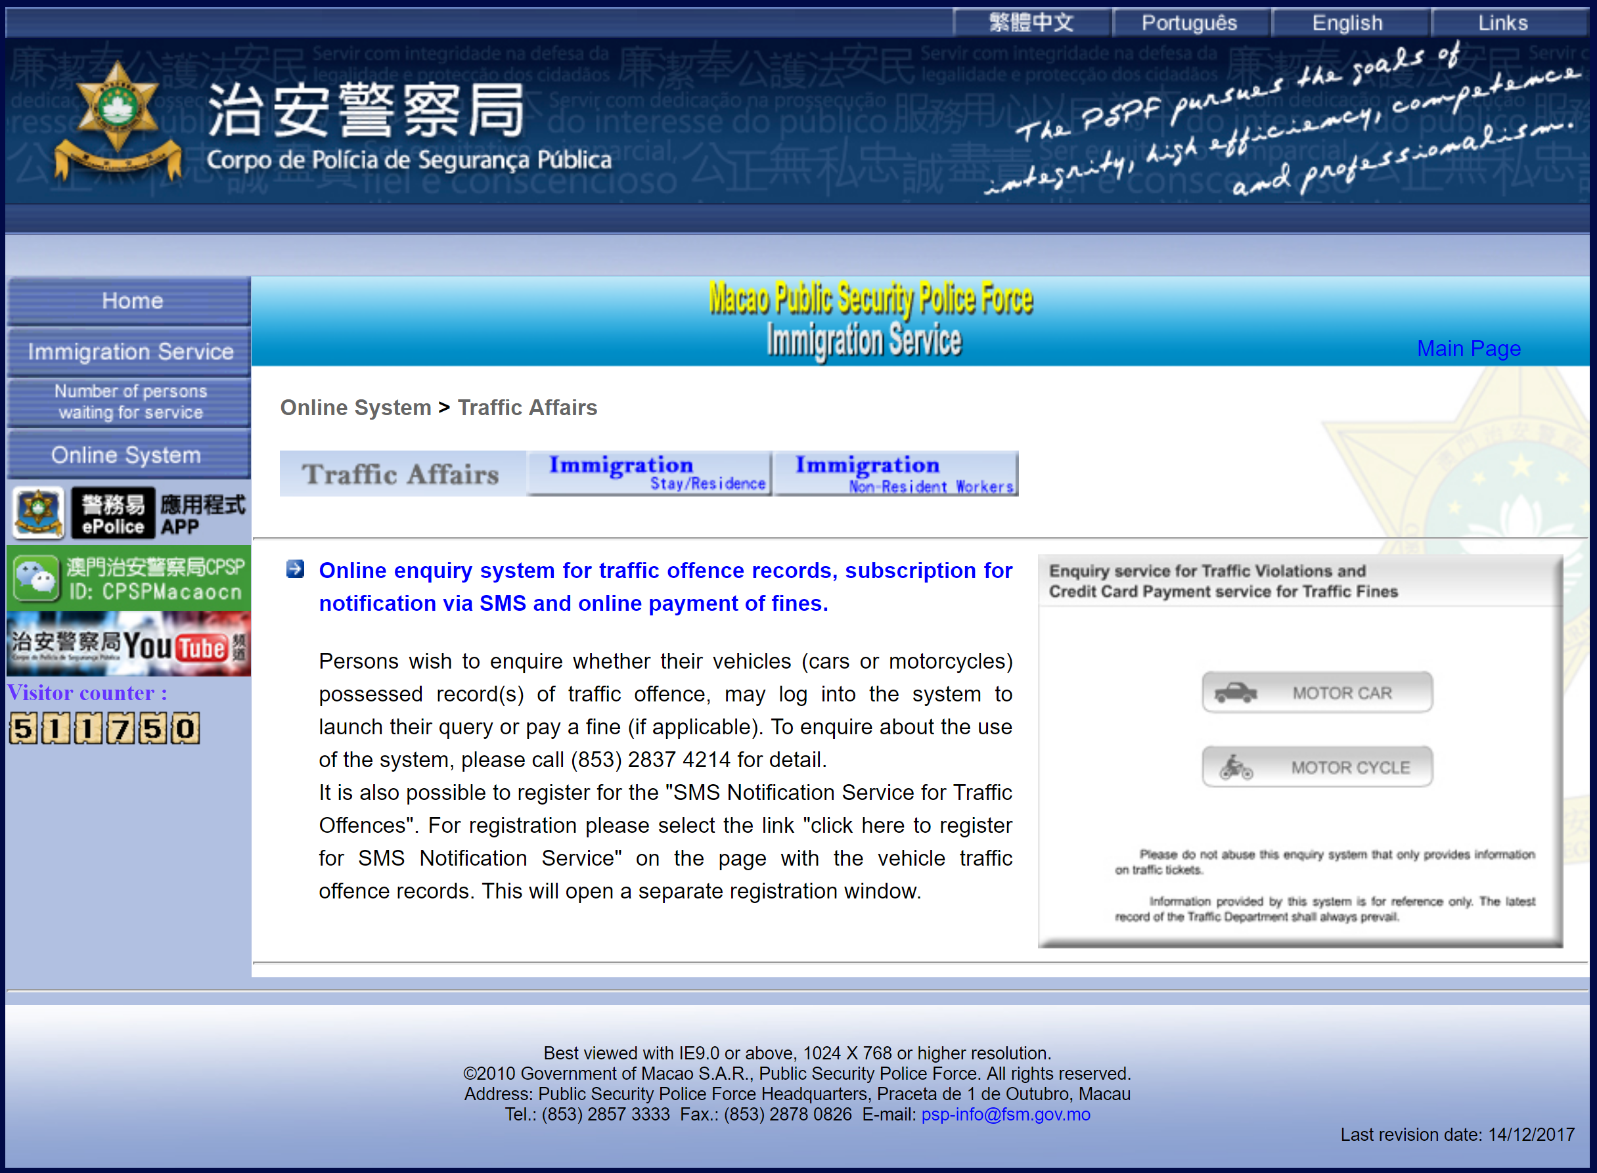

Slide 11
Strategies for E-Government
There are two forms of strategy relevant to e-government:
National e-strategy
National e-government strategy
A national e-strategy is where the government sets out its vision, intentions and targets regarding the creation of an “information society.” At this level, e-government may, or may not, be a key focus – the emphasis is on overcoming digital divide issues and building infrastructure (precursors to e-government) as well as economic growth and national competitiveness.
National e-government strategies are centered on rolling out e-government and the reform of public sector services.

Slide 12
E-government Maturity Models
E-government maturity models outline the likely trajectory of e-government development.
The models provide a structure to think about historic, current and future developments in applications of e-government and they provide a “hook” around which to base discussion of the technological and management issues.
Layne and Lee’s model has to dimensions:
The extent of integration of services provided
The complexity of the technological and organizational challenges

Slide 13
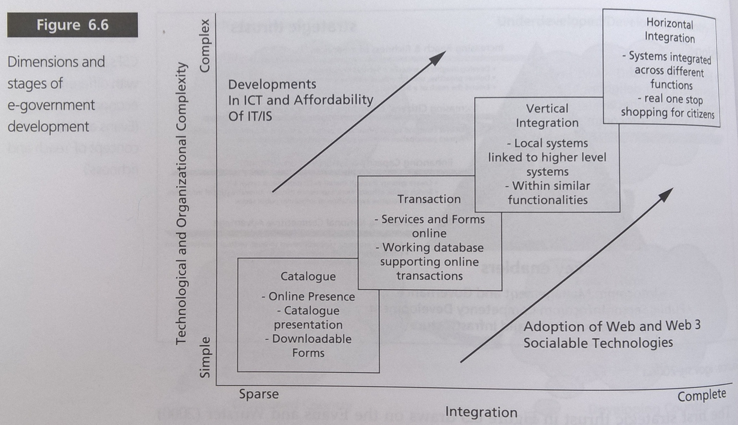
E-government Maturity Models (Cont’d)

Slide 14
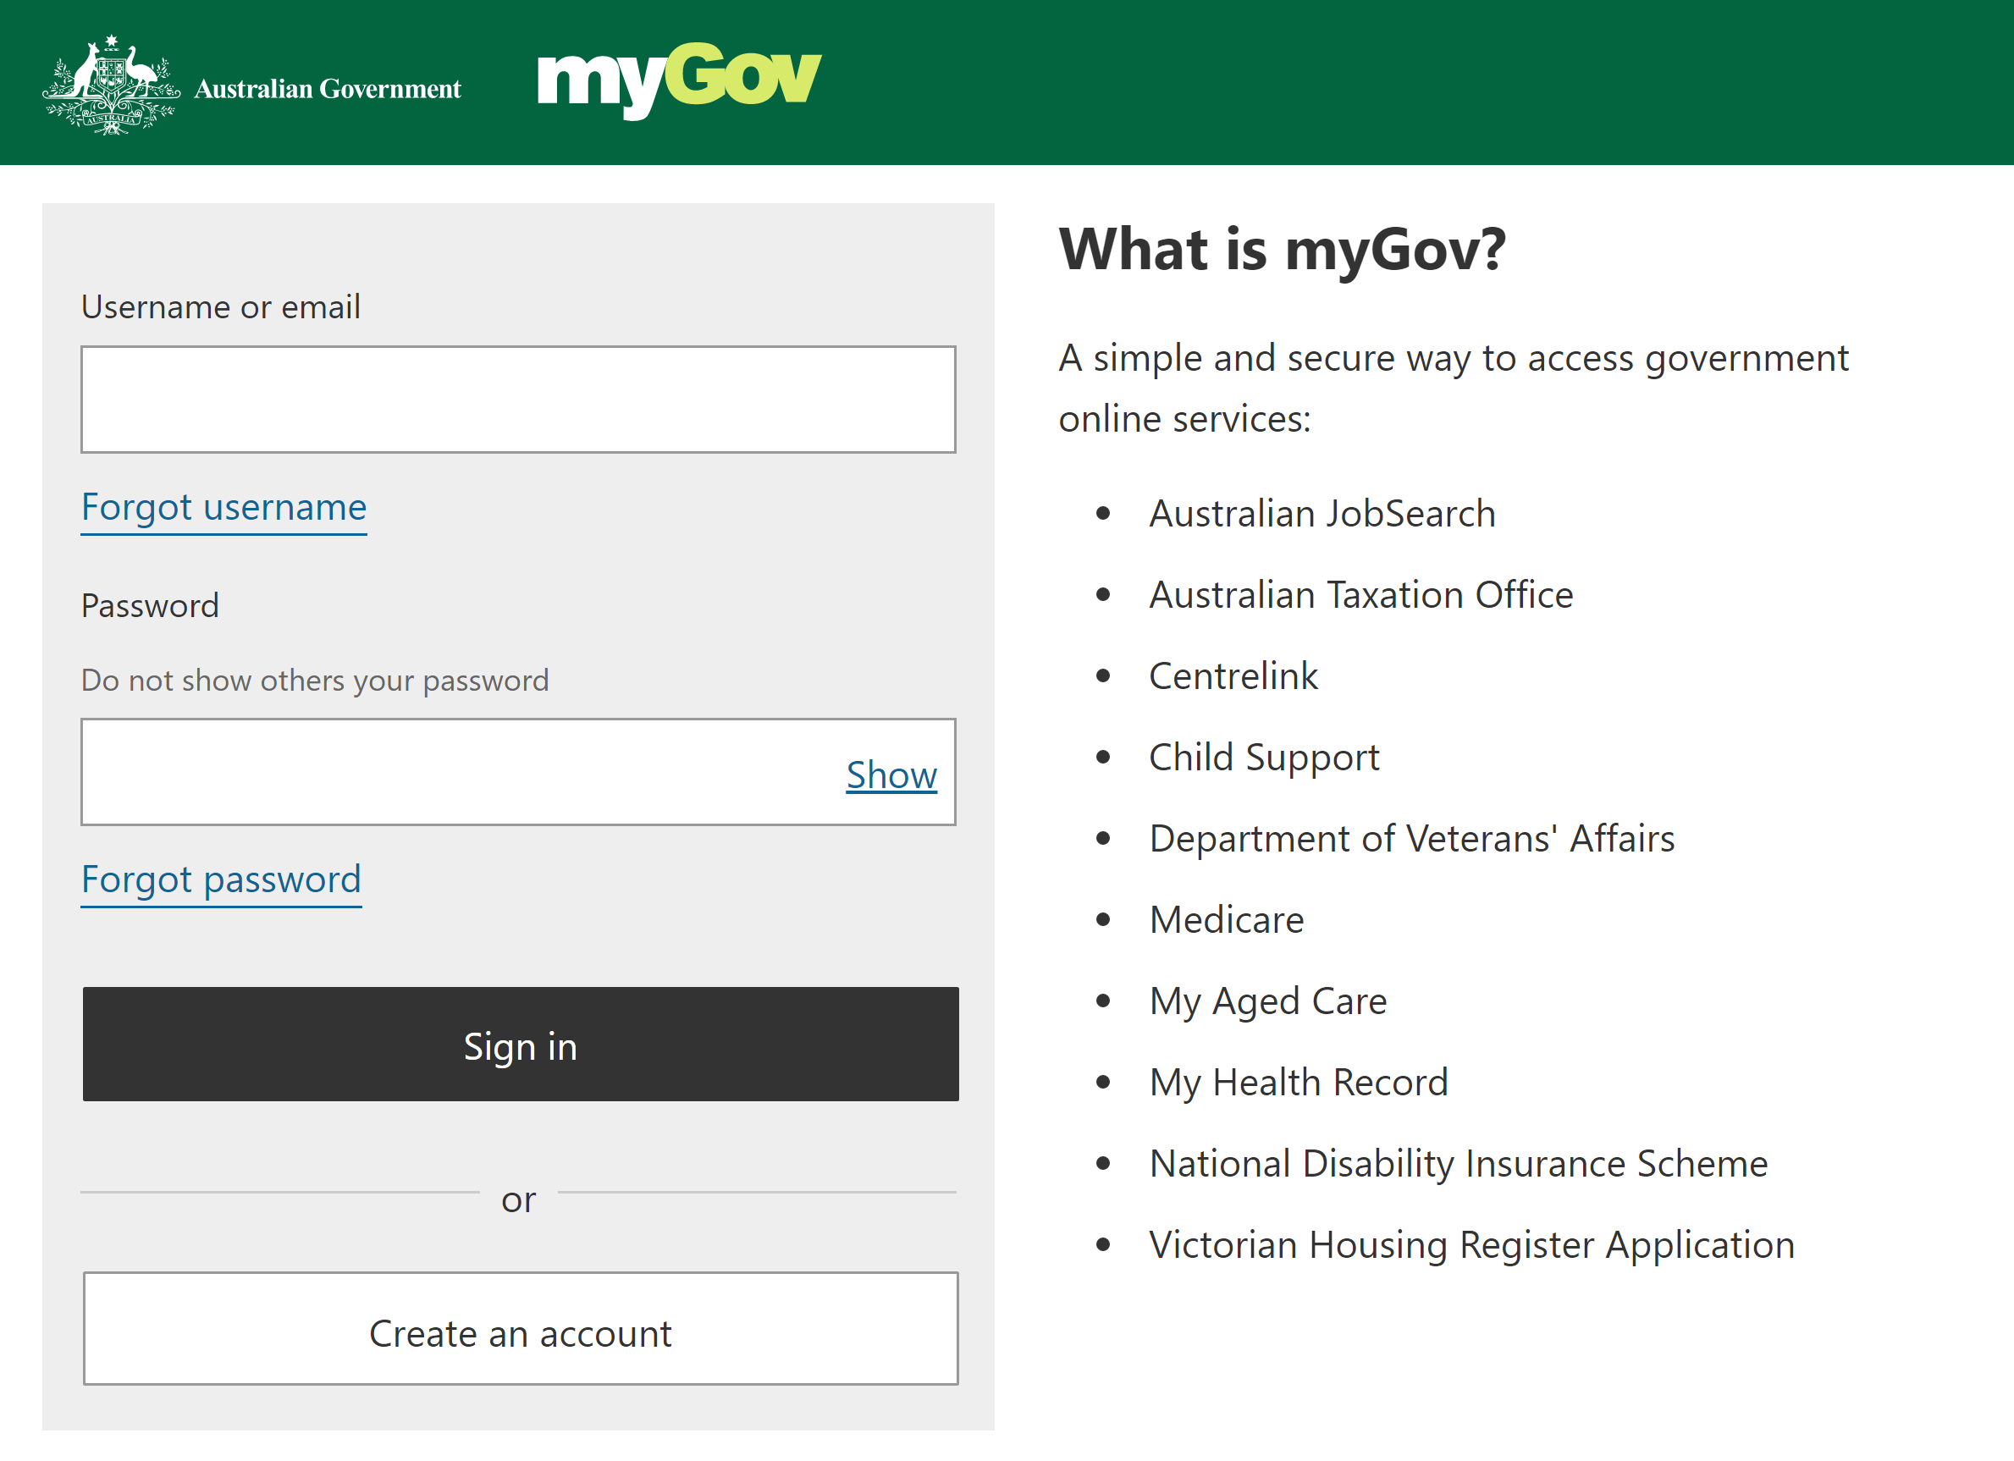
Issues and Challenges in E-Government
Strategic IS planning in the public sector: Is there a need?
Interoperability: the ability of government organizations to share and integrate information and business processes by use of common standards and work practices.
Trust and security
The use of consultants
May be required due to absence of organizational knowledge and expertise regarding IS/IT
Has spending and cost implications
Emerging technologies
M-government

Slide 15
What are SMEs?
In general, definitions of SMEs relate to combinations of the following: number of employees, turnover and the notation that the SME is an independent entity.
European Union definition of SMEs (2005)
Category | Staff Headcount | Turnover | Or | Balance Sheet Total
Medium-sized | < 250 | ≤ € 50 million | Or | ≤ € 43 million
Small | < 50 | ≤ € 10 million | Or | ≤ € 10 million
Micro | < 10 | ≤ € 2 million | Or | ≤ € 2 million

Slide 16
Why are SMEs important?
In many countries, SMEs are a major source of entrepreneurial skills, innovation and employment.
SMEs also play a leading role in the development of new technologies and the creation of innovative products and often stimulate competition and innovation throughout the economy as a whole.

Slide 17
** What is distinctive about SMEs?
Organizational structure: Typically a flat structure which is centralized as the owner and manager may carry out multiple roles. Tasks and functions are less strictly divided. Few SMEs have formal internal communication mechanism in place.
Enterprise/dynamism: Entrepreneurial attributes such as creativity, flexibility and dynamism are associated with the SME sector. SMEs may outperform large organizations in terms of responsiveness to customer needs, flexibility, the ability to identify and exploit opportunities, and to adopt to technologies.
Resource poverty: SMEs may experience a limited resource base in relation to access to capital, external information and expertise.
The use of consultants may be expensive.

Slide 18
What is distinctive about SMEs? (Cont’d)
External environment: SMEs have little to no control over their external environment and face pressure from the power of their suppliers and customers resulting in them being price takers rather than price setters.
Strategy/planning: Strategic planning in the formal manner documented in strategic management texts may be an intangible, invisible, and almost unconscious process. This raises the question as to whether the strategic planning processes and frameworks in the literature are appropriate for SMEs.
The importance of the owner/manager: The role, expertise and attitude of the owner/managers of an SME are crucial. An organization that chooses stability as its goal may operate differently from a growth-oriented SME, and this difference may be reflected in how it deploys and uses IS/IT.

Slide 19
SMEs and IS/IT
What might drive an SME to adopt ICTs?
Reducing cost (operating, sales, purchasing)
Market share (increasing/avoiding loss of)
Information gathering: market intelligence and finding suppliers
Improved range and quality of products/services to customers
Increased speed in dispatch of goods
Improved trading relationships

Slide 20
SMEs and IS/IT (Cont’d)
Inhibitors of ICT adoption:
Inhibitor | Description
Cost | Implementation and ongoing costs Limited financial resources and capital reserves Need for immediate return on investment or payback
Management | Insufficient time spent on planning Insufficient knowledge or experience of IT/IS
Security | Concerns about confidentiality Fear of fraud
Technology | Complexity requiring new skills Existing IT/IS limiting future development Lack of trust in external IS suppliers Limited in-house IT/IS skills

Slide 21
Planning for IS/IT in SMEs
The Information Systems Strategy Framework for SME (Levy and Powell 2005) has three perspectives:
Business context: The business strategy and objective are identified. The business environment is reviewed.
Business process: The firm’s internal and external processes are reviewed. Existing IS needs are assessed in relation to the business objectives.
Strategic content: The strategic content embodies the vision for change from the owner and the practicality of its introduction. The requirements of the business strategy are compared with the analysis of the organization and its environment to identify the IS and IT required. With limited resources available, systems and investments will have to be evaluated and prioritized.

Slide 22
Chapter Summary
Key learning points from Grant et al. Chapter 6:
E-government is a global phenomenon
SMEs are typically characterized by flat organizational structures, centralized management and decision making; limited strategic planning and resource poverty. The expertise, attitudes and behaviors of the owner/managers are crucial to the well-being and direction of the business.
SMEs are not a homogeneous group.
There is a need to reflect on whether IS/IM tools and frameworks developed for one particular organizational context are appropriate in other contexts.

